Slide 1

Experiencing M I S
Ninth Edition
Chapter 5
Database Processing
Slides in this presentation contain hyperlinks. JAWS users should be able to get a list of links by using INSERT+F7
Copyright © 2021, 2019, 2017 Pearson Education, Inc. All Rights Reserved
Notes:
If this PowerPoint presentation contains mathematical equations, you may need to check that your computer has the following installed:
1) MathType Plugin
2) Math Player (free versions available)
3) NVDA Reader (free versions available)

Slide 2
“The tricky part is getting the computer to correctly identify the inventory item.”
eHermes is using Google’s image classifier API to identify images that customers upload.
Costs a few dollars per 1000 images searched
Need new data storage
Need redesigned database
Need new DBMS
Will be sending and receiving data from multiple data sources
MongoDB for tracking image files?
Notes:
GOALS
Illustrate the utility of analysis from operational data.
Set up the need for NoSQL databases like those processed by MongoDB.
Go to the MongoDB for video storage to learn about its capabilities.

Slide 3
Study Questions
5-1 Why do you need to know about databases?
5-2 What is a database?
5-3 What is a database management system (D B M S)?
5-4 How do database applications make databases more useful?
5-5 How can eHermes benefit from a database system?
5-6 What are nontraditional D B M S products?
Notes:
This chapter addresses the why, what, and how of database processing. It begins by describing the purpose of a database and then explain the important components of database systems.
Next, discuss data modeling and show how IS professionals use data models to design database structure.
It discusses how a database system could be used to solve the tracking problem at eHermes.
It wraps up with discussion of new database technology.

Slide 4
Why Use a Database?
5-1 Why do you need to know about databases?
Can database technology facilitate your project goals?
Databases are ubiquitous in commerce.
How to turn data into useful information.
Business adaptation requires changing database structure.
As a future business professional, you might need to build a database.

Slide 5
What is the Purpose of a Database?
5-1 Why do you need to know about databases?
Organize and keep track of things.
Keep track of multiple themes.
General rule:
Single theme—store in a spreadsheet.
Multiple themes—use a database.
What’s a theme?
Ex: student grades, student emails, student office visits.
Notes:
General rule:
Use a spreadsheet for lists of data involving single theme.
Use a database for data with multiple themes.

Slide 6
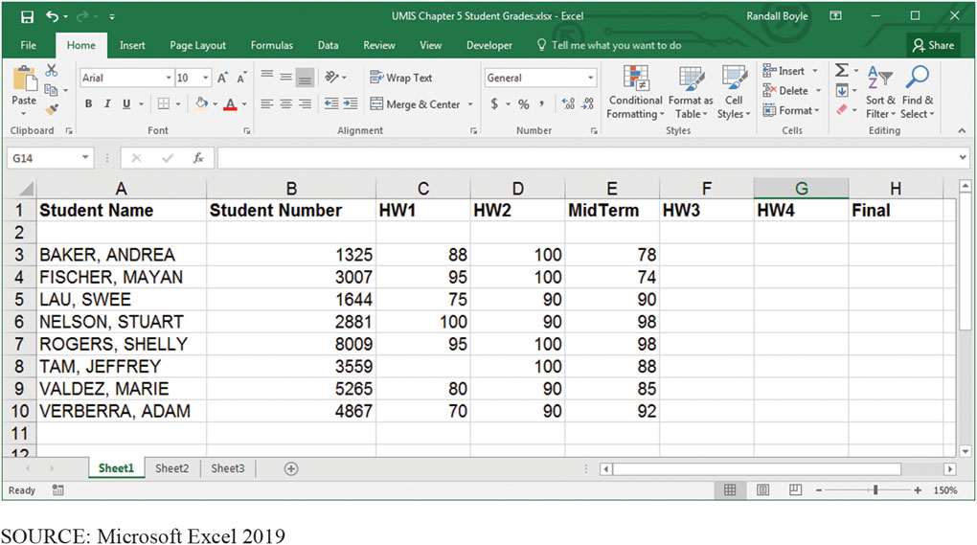
A List of Student Grades Presented in a Spreadsheet – Single Theme
5-1 Why do you need to know about databases?
Figure 5-1 A List of Student Grades Presented in a Spreadsheet
Notes:
Key distinction between this figure and next slide: here, Student Grades is the only theme. Email and Office Visit data are not included. Next slide shows how the database enables us to view all three themes at once.

Slide 7
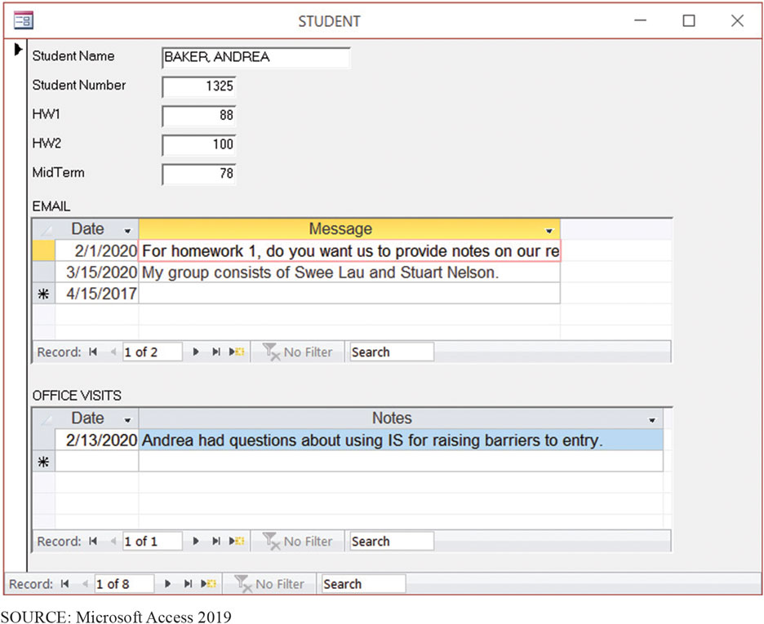
Student Data Form for a Database Application
5-1 Why do you need to know about databases?
Figure 5-2 Student Data Shown in a Form from a Database
Notes:
Forms are difficult, if not impossible, to produce with a spreadsheet, but are easily produced with a database.

Slide 8
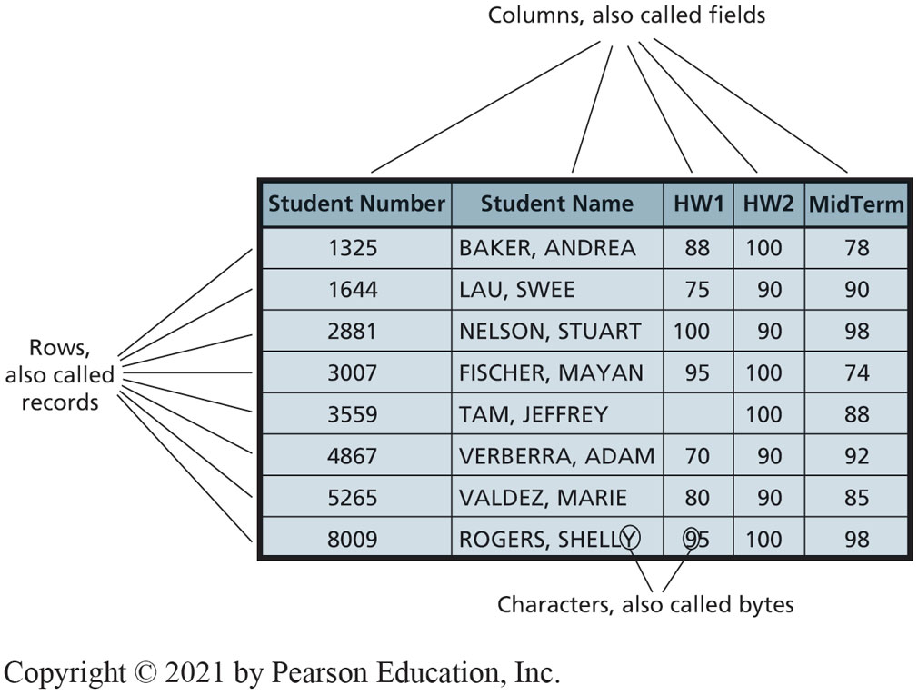
What is a Database?
5-2 What is a database?
Figure 5-3 Student Table (also called a file)
Notes:
Relationships of rows and columns in a database.
Database—self-describing collection of integrated records.

Slide 9
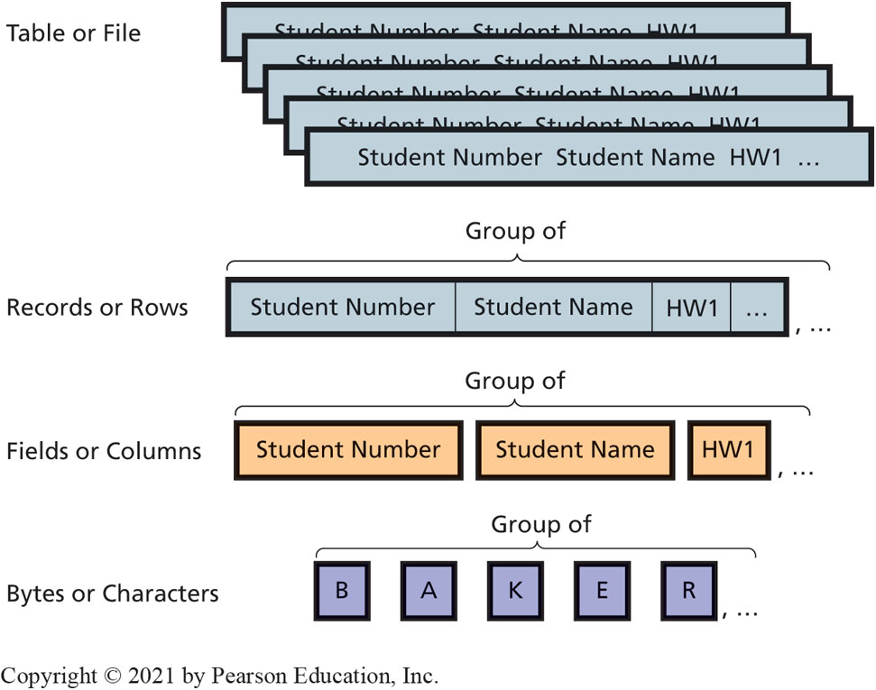
Hierarchy of Data Elements
5-2 What is a database?
Figure 5-4 Hierarchy of Data Elements
Notes:
Database is a collection of related tables.

Slide 10
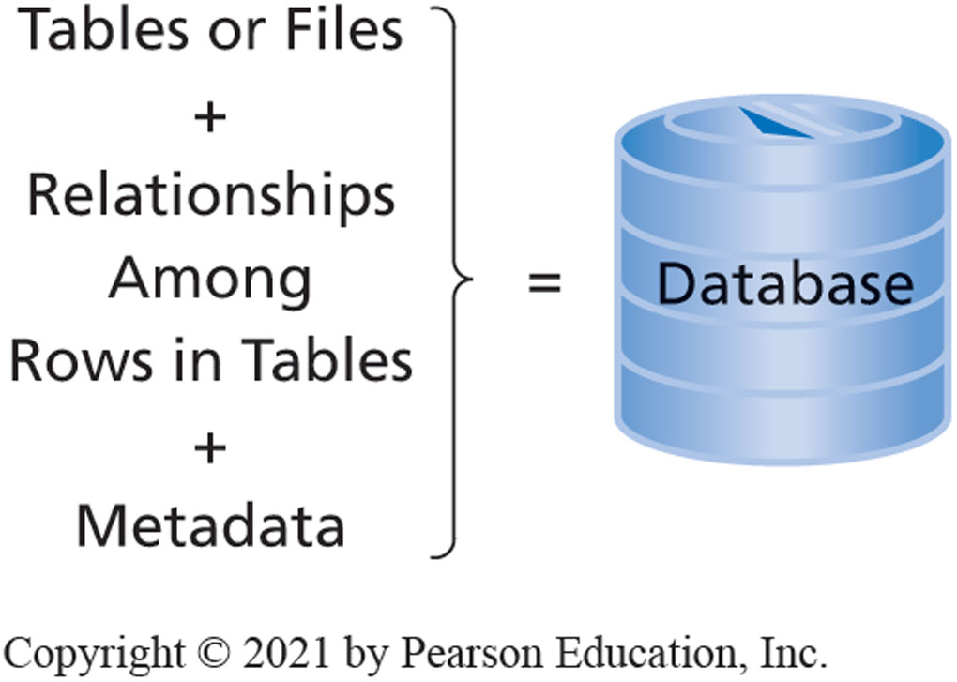
Components of a Database
5-2 What is a database?
Figure 5-5 Components of a Database
Notes:
Formal term for table is “relation.” Linking relations together creates relationships. A database is a group of related tables. Metadata describes definitions of tables, fields, and relationships.

Slide 11
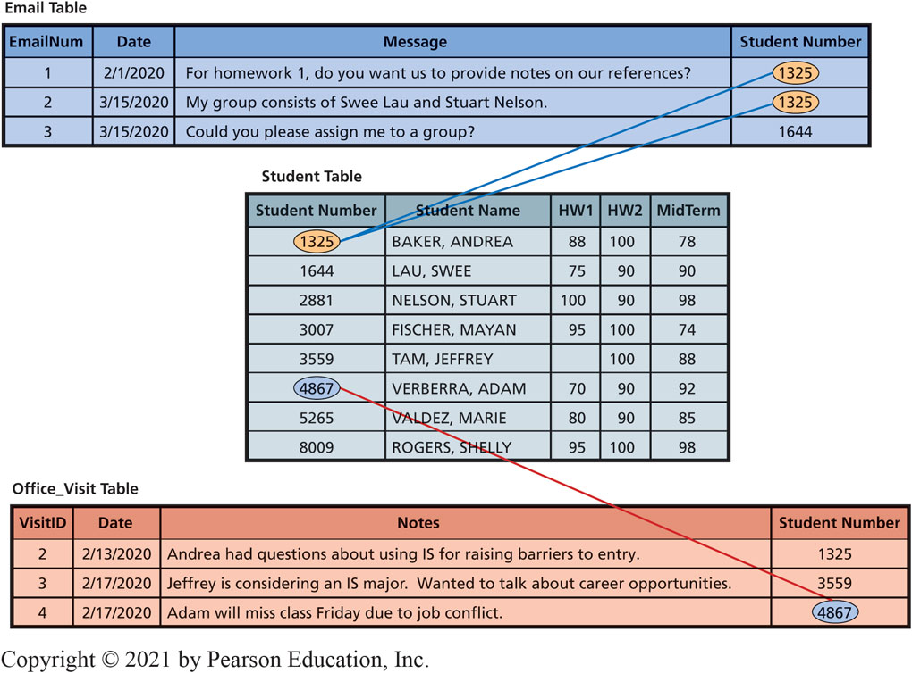
Example of Relationships Among Rows
5-2 What is a database?
Figure 5-6 Example of Relationships Among Rows
Notes:
Foreign keys of top and bottom tables related to primary keys of Student Table.

Slide 12
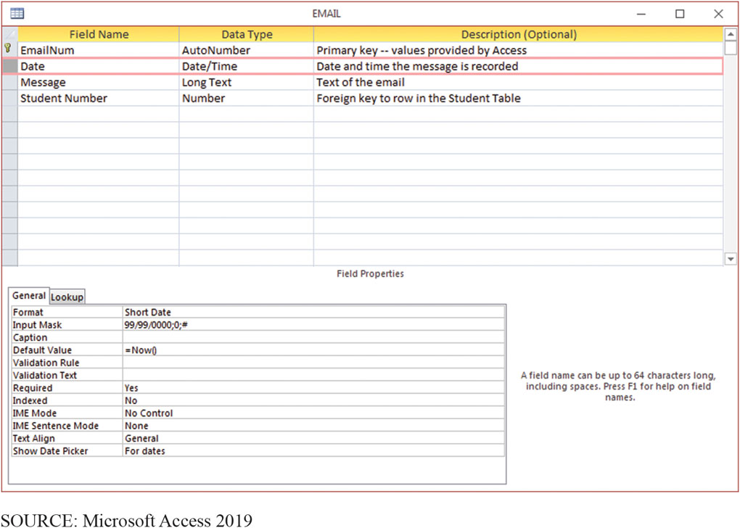
Sample of Access Metadata
5-2 What is a database?
Figure 5-7 Sample Metadata (in Access)
Notes:
Microsoft Access example of metadata for the Email table. Metadata makes a database self-describing.

Slide 13
Database Management System (D B M S)
5-3 What is a database management system (D B M S)?
Functions of a D B M S
Creating the Database and its structures
Processing the database
Administering the database
Licensed from vendors
I B M, Microsoft, Oracle, and others.
D B2, Access, S Q L Server, Oracle Database.
Open source
My S Q L: License-free for most applications.

Slide 14
Processing the Database (1 of 2)
5-3 What is a database management system (D B M S)?
Creating the database (see form in Figure 5-7)
Modifying the database structure (see Figure 5-8)
D B M S Process Operations
Read
Insert
Modify
Delete data
Notes:
These operations are requested in applications that call upon DBMS in different ways.

Slide 15
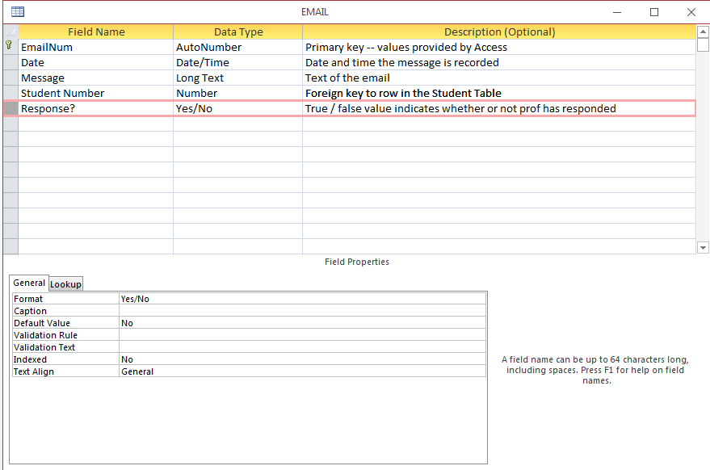
Adding a New Column to a Table (in Access 2019)
5-3 What is a database management system (D B M S)?
Figure 5-8 Adding a New Column to a Table (in Access)
Source: Microsoft Access 2019
Notes:
No SQL knowledge needed to add column to table.

Slide 16
Processing the Database (2 of 2)
5-3 What is a database management system (D B M S)?
Structured Query Language—S Q L (see-quell)
International standard
Used by nearly all D B M S
S Q L Example
INSERT INTO Student
([Student Number], [Student Name], H W1, H W2, MidTerm)
VALUES (1000, ‘Franklin, Benjamin’, 90, 95, 100);
Notes:
Structured Query Language (SQL) used for processing the database. SQL—international standard language for creating databases and database structures, and processing databases. Used by all popular DBMS products.

Slide 17
Slick Analytics (1 of 2)
So What?
C I O s are looking to merge the storage and analysis of cloud-based data into one synergistic operation.
Laredo Petroleum.
Old approach used numerous spreadsheets and manual calculations.
Value of data diminished due to the time it took to analyze the data.
New approach uses cloud storage and cloud analytics.

Slide 18
Slick Analytics (2 of 2)
So What?
Laredo Petroleum.
Needs to know when it should clean chemical deposits in its wells.
Cloud storage and analytics improved scalability, robust data analysis, and data accessibility.
Cloud analytics will grow by 46 percent through 2020.
Security and privacy concerns are drawbacks to cloud services.

Slide 19
Administering the Database
5-3 What is a database management system (D B M S)?
Set up security system, user accounts, passwords, permissions, limits for processing.
Limit user permissions.
Back up database, improve performance of database applications, remove unwanted data.
Notes:
Third DBMS function is to provide tools to assist in the administration of the database.

Slide 20
Summary of Database Administration Tasks (1 of 2)
5-3 What is a database management system (D B M S)?
Figure 5-9 Summary of Database Administration (D B A) Tasks (continues on next slide)
Category | Database Administration Task | Description
 | Create and staff D B A function | Size of D B A group depends on size and complexity of database. Groups range from one part-time person to small group.
 | Form steering committee | Consists of representatives of all user groups. Forum for community-wide discussions and decisions.
Development | Specify requirements | Ensure that all appropriate user input is considered.
 | Validate data model | Check data model for accuracy and completeness.
 | Evaluate application design | Verify that all necessary forms, reports, queries, and applications are developed. Validate design and usability of application components.
Operation | Manage processing rights and responsibilities | Determine processing rights/restrictions on each table and column.
 | Manage security | Add and delete users and user groups as necessary; ensure that security system works.

Slide 21
Summary of Database Administration Tasks (2 of 2)
5-3 What is a database management system (D B M S)?
Figure 5-9 Summary of Database Administration (D B A) Tasks (con’t.)
Category | Database Administration Task | Description
 | Track problems and manage resolution | Develop system to record and manage resolution of problems.
Operation | Monitor database performance | Provide expertise/solutions for performance improvements.
 | Manage D B M S | Evaluate new features and functions.
 | Monitor backup procedures | Verify that database backup procedures are followed.
Backup and Recovery | Conduct training | Ensure that users and operations personnel know and understand recovery procedures.
 | Manage recovery | Manage recovery process.
 | Set up request tracking system | Develop system to record and prioritize requests for change.
Adaptation | Manage configuration change | Manage impact of database structure changes on applications and users.
Notes:
DBMS provides tools to assist in database administration. Database administration involves a wide variety of activities.
Permissions can be limited in very specific ways.

Slide 22
Forms, Queries, Reports, and Applications
5-4 How do database applications make databases more useful?
Forms | View data; insert new, update existing, delete existing data.
Reports | Structured presentation of data using sorting, grouping, filtering, other operations.
Queries | Search using values provided by user.
Application programs | Provide security, data consistency, special purpose processing, e.g., handle out-of-stock situations.
Notes:
Elements of Database Applications

Slide 23
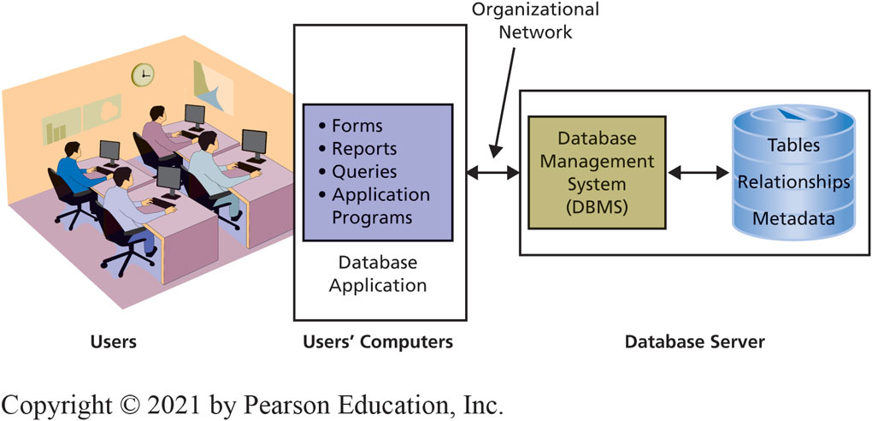
Users Accessing Databases
5-4 How do database applications make databases more useful?
Figure 5-10 Processing Environment of a Traditional Database Application System
Notes:
Traditional Database Application System processing environment.
Users interact with the database application.
The DBMS acts as an interface between user applications and the actual database.

Slide 24
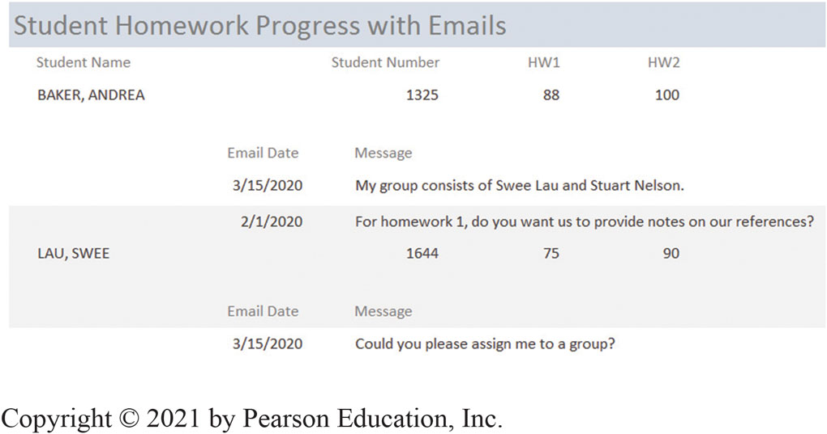
Example of a Student Report
5-4 How do database applications make databases more useful?
Figure 5-11 Example of a Student Report

Slide 25
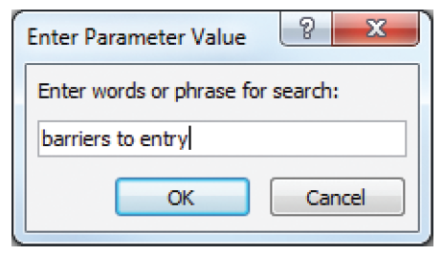
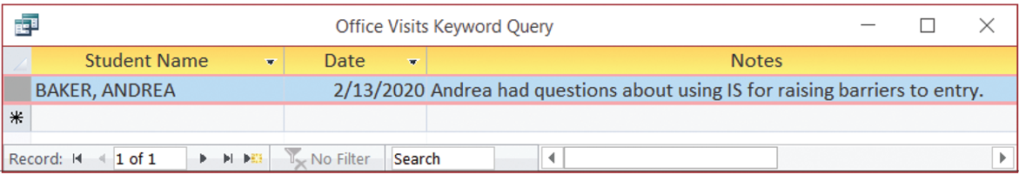
Query Example
5-4 How do database applications make databases more useful?
Figure 5-12A Sample Query Form Used to Enter Phrase for Search
Figure 5-12B Sample Query Results of Query Operation
Source: Microsoft Corporation
Source: Microsoft Access 2019
Notes:
Typical database application report, query form, and query report. Structure of this report creates information because it shows student data in a context meaningful to the professor.
DBMS programs provide comprehensive and robust features for querying database data.

Slide 26
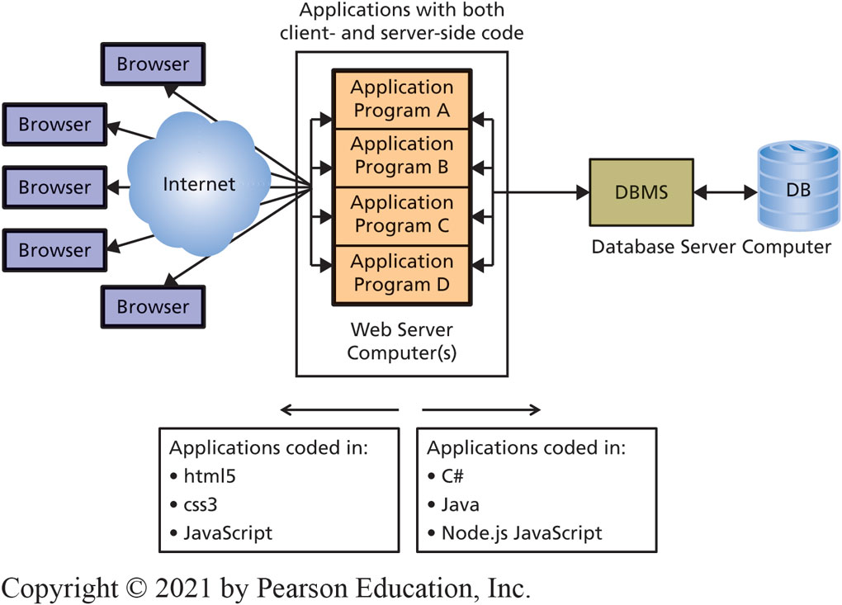
Browser Forms, Reports, Queries, and Applications
5-4 How do database applications make databases more useful?
Figure 5-13 Processing Environment of Browser-Based Database Applications
Notes:
Traditional database applications programs, written in object-oriented languages such as C++ and VisualBasic, and even COBOL, are thick applications.
In some cases, all application logic is contained program on users’ computers and server does nothing except run the DBMS and serve up data.
In others, some application code is placed on both users’ computers and database server computer.

Slide 27
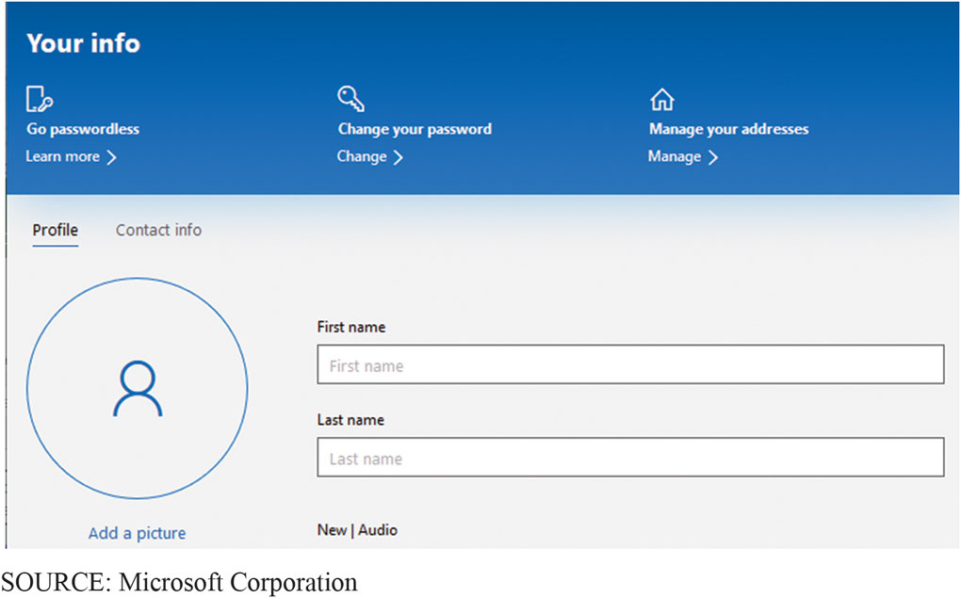
Account Creation Browser Form
5-4 How do database applications make databases more useful?
Figure 5-14 Microsoft Office 365 User Account Form

Slide 28
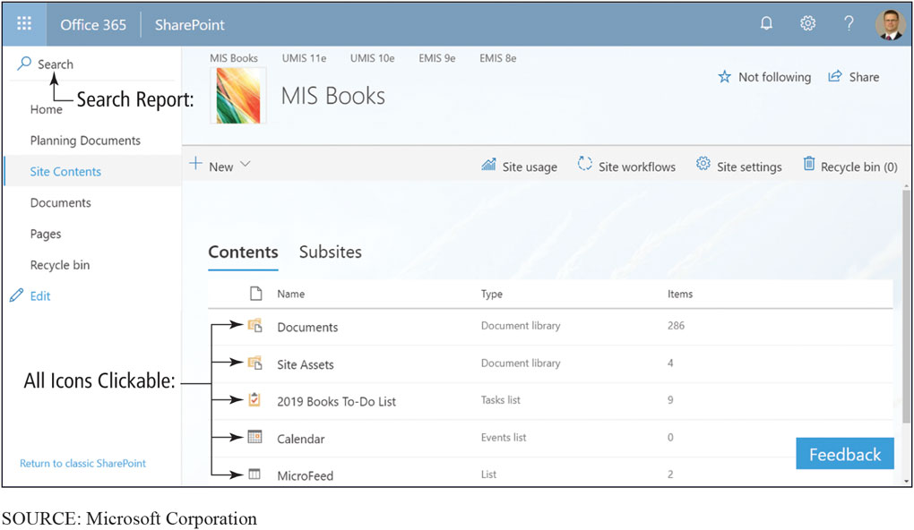
Browser Report
5-4 How do database applications make databases more useful?
Figure 5-15 Browser Report for SharePoint Site
Notes:
The content is dynamic; almost all of the items can be clicked to produce other reports or take other actions. The user can search in the box in the upper-right-hand corner to find specific items.

Slide 29
Multiuser Processing Problem
5-4 How do database applications make databases more useful?
Andrea reads available tickets record showing 2 tickets.
3. Andrea puts both in shopping basket, but delays checking out.
5. Andrea proceeds to checkout. Someone will be disappointed.
1
2
3
4
5
1
2
3
4
5
Jeffrey reads same record showing 2 available tickets.
Jeffrey puts both in shopping basket and checks out before Andrea.
Notes:
Lost-update problem is one of the special characteristics of multiuser database processing. To prevent this problem, some type of locking must be used to coordinate the record update activities of multiple users. Locking has own set of problems and those problems must be addressed as well.
Realize converting a single-user database to a multiuser database requires more than simply connecting another computer. The logic of the underlying application processing needs to be adjusted also. If you find inaccurate results, you may be experiencing multiuser data conflicts. Contact your IS department for assistance.

Slide 30
A Database System at eHermes
5-5 How can eHermes benefit from a database system?
Speed up the process of inventorying new items received from sellers.
“Can we add a new item’s entry in our database using a photo and Google’s image classifier to recognize the item, search for product information from multiple sources, and complete the database entry?”
Choices
Store images on a file server and keep metadata about each image in a relational database to query with S Q L.
Use No S Q L Mongo D B to store images in same database as the metadata.
Notes:
Sample query.

Slide 31
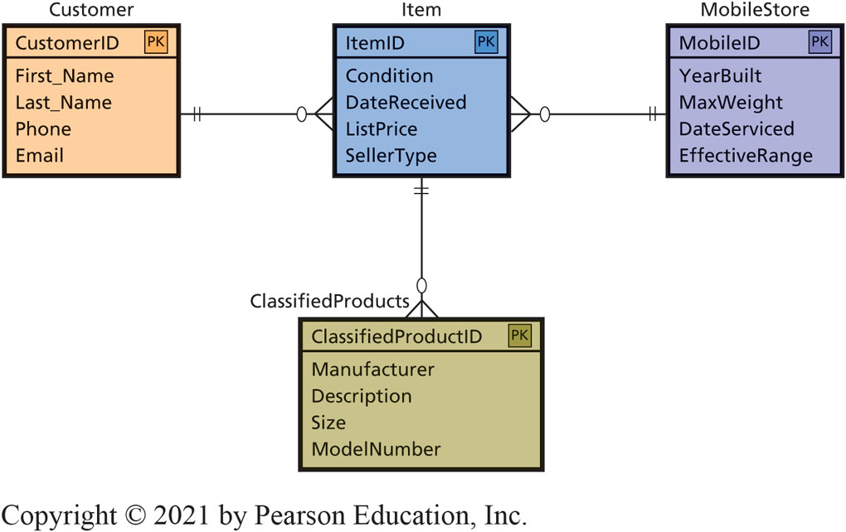
eHermes Chooses Option 1
5-5 How can eHermes benefit from a database system?
Use Microsoft SQL Server to store metadata.
Less risky: uses known technology.
Creates E-R diagram.
Decide to keep design simple at first.

Slide 32
Nontraditional D B M S Products
5-6 What are nontraditional D B M S products?
Relational model is not needed today
Need to store new data types differently
Atomic, Consistent, Isolated, Durable transactions
Critical to traditional commercial applications
New Internet applications (Twitter) don’t need A C I D
NoSQL (nonrelational) DBMS
DBMS products that support high transaction rates, simple data structures, replicated on many servers in the cloud, without ACID transaction support.
Notes:
Limitations were removed by improved storage and processing technology, and today they do not exist.
Either all of a transaction is processed or none of it is (atomic). Transactions are processed in the same manner (consistent) whether processed alone or in the presence of millions of other transactions (isolated). Once a transaction is stored it never goes away—even in the presence of failure (durable).
ACID transactions are critical to traditional commercial applications. Even in the presence of machine failure,

Slide 33
Need for Faster Processing Using Many Servers
5-6 What are nontraditional D B M S products?
Dynamo
Amazon-developed nonrelational data store
Bigtable
Google-developed nonrelational data store
Cassandra
Facebook-developed using concepts from both Dynamo and Bigtable
Top-Level Project (T L P)
Open-source Cassandra by Apache

Slide 34
New Categories of D B M S
5-6 What are nontraditional D B M S products?
New S Q L D B M S
Process very high levels of transactions, like No S Q L D B M S, but provide A C I D support.
May or may not support relational model.
Current hotbed of development.
In-memory D B M S using S Q L extension
S A P H A N A, Tableau.
High volume A C I D transaction support with complex relational query processing.
Notes:
SAP HANA is a computer with an in-memory DBMS that provides high-volume ACID transaction support simultaneously with complex relational query processing.
Tableau Software’s reporting products are supported by a proprietary in-memory DBMS using an extension to SQL.

Slide 35
Will These New Products Replace the Relational Model?
5-6 What are nontraditional D B M S products?
Probably not.
Conversion enormously expensive and disruptive
No S Q L D B M S products very technical and require a deep background in computer science to use
No S Q L’s impact on D B M S product market?
Database software market experience viable new entrants

Slide 36
What Do Nonrelational DBMS Mean for You?
5-6 What are nontraditional D B M S products?
What do nonrelational D B M S mean for you?
Knowledge is useful—stay abreast of developments
Watch nonrelational D B M S product developments from an investor’s perspective
New opportunities and career paths will develop around nonrelational databases
Use knowledge to separate yourself from competition when it comes to job interviews

Slide 37
How does the knowledge in this chapter help you?
Understand purpose of a database and ways databases are processed
Know about new categories of nontraditional D B M S
This knowledge will enable you to be an effective team member when your organization has needs like those at eHermes

Slide 38
Querying Inequality?
Ethics Guide
Increasing value of cryptocurrency makes mining an attractive prospect for Richard’s boss Steve.
Richard discovers a crypto-mining program running on company servers.
Only runs at night and during off hours
Probably will only increase electricity consumption
What would you do from a categorical imperative and utilitarian perspectives?
Notes:
GOALS
Set up a realistic situation that raises important ethical issues. Ask students what they think should be done.
Questions:
Richard is probably the only other person in the company who could detect Steve’s mining scheme. How important is it to have ethical employees in positions that can’t be easily audited or checked? For these types of positions, is it better to hire a person who behaves ethically but has limited technical skills, or is it better to hire a highly skilled person with moral flexibility?
It’s unlikely the company has a policy against using too much CPU power; this wasn’t even an issue before crypto-mining became popular. Even if Richard turned Steve in, could Steve simply claim he wasn’t violating corporate policy? How might Steve justify his mining activities and avoid being fired?
Suppose Steve goes to his boss and tells her about his idea. He reminds her that the main corporate office pays all the power bills, so they could just keep the profits within the IT group. Essentially, they could increase their departmental budget by “efficiently” using existing resources. Steve could covertly skim a small percentage off the top for himself and be protected from getting fired at the same time. He might even get a raise. How would you feel if you were the CEO of the company and found out about this sort of crypto-mining activity? How would you respond to the IT group?

Slide 39
Data Engineer
Career Guide
Kailey Smith at Haven
Q. What attracted you to this field?
A. “I've always enjoyed working with computers and figuring things out, but after taking my first information systems course…I was sold. This is a field that will be growing and expanding with new and exciting opportunities. There are so many different areas to explore, and you can definitely be paid pretty well!”
Q. What advice would you give to someone who is considering working in your field?
A. “Keep an open mind. Try out new things. When I was in school, I was focused on the security side of things because it sounded more exciting, but I ended up working more on the data side. Figure out what really excites you, but the more you learn, the more opportunities will open up to you.”

Slide 40
Active Review
5-1 Why do you need to know about databases?
5-2 What is a database?
5-3 What is a database management system (D B M S)?
5-4 How do database applications make databases more useful?
5-5 How can eHermes benefit from a database system?
5-6 What are nontraditional D B M S products?
Notes:
This chapter addresses the why, what, and how of database processing. It begins by describing the purpose of a database and then explain the important components of database systems.
Next, discuss data modeling and show how IS professionals use data models to design database structure.
It discusses how a database system could be used to solve the tracking problem at eHermes.
It wraps up with discussion of new database technology.

Slide 41

Dean’s Piano Database
Case Study 5
Certified piano tuner and technician repairing and restoring pianos for many years.
Clown entertainer at children’s parties.
Figure 5-17 Deano the Clown
Source: Dean Petrich

Slide 42
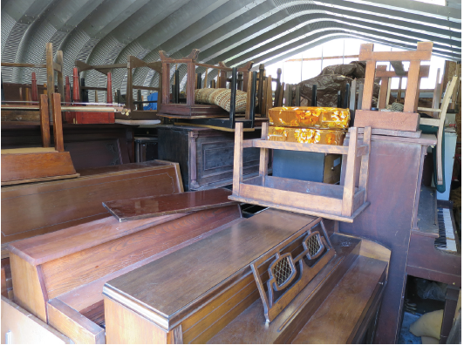

Pianos in Storage
Case Study 5
Figure 5-18 Pianos in Storage
Figure 5-19 Pianos in Tent
Source: David Kroenke
Source: David Kroenke

Slide 43
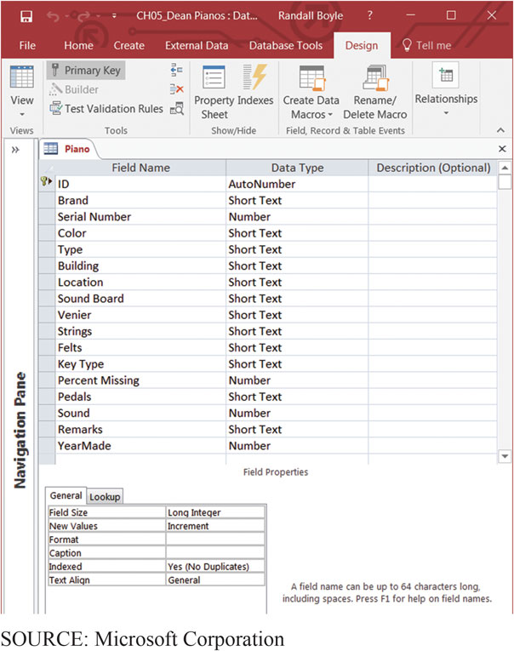
Columns in the Piano Table
Case Study 5
Figure 5-20 Columns in the Piano Table
Notes:
Dean created a Microsoft Access database with only one table: Piano.
Used Access because he wants to query his data in a variety of ways.
Because of the dynamic nature of his needs, Dean uses the Access query facility.

Slide 44
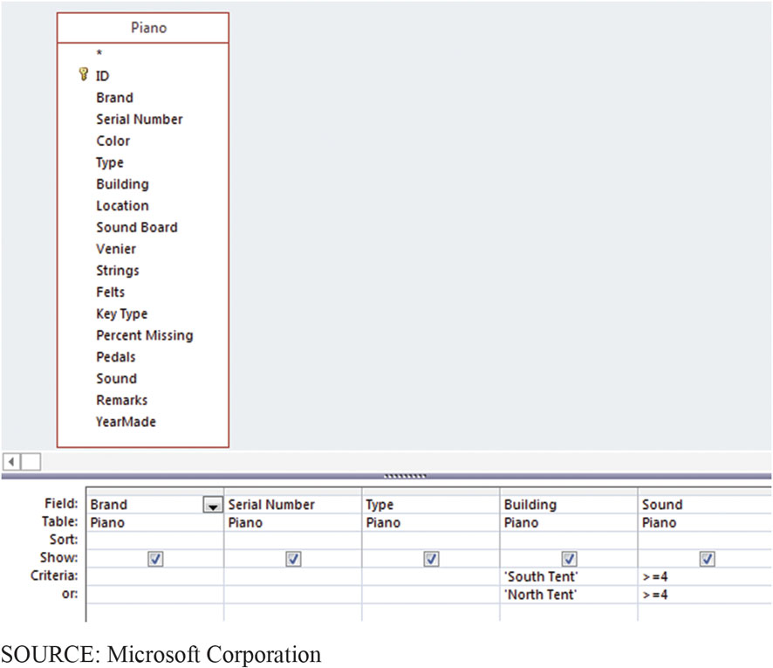
Query Design and Result
Case Study 5
Figure 5-21 Example of Access Query
Source: Microsoft Corporation

Slide 45
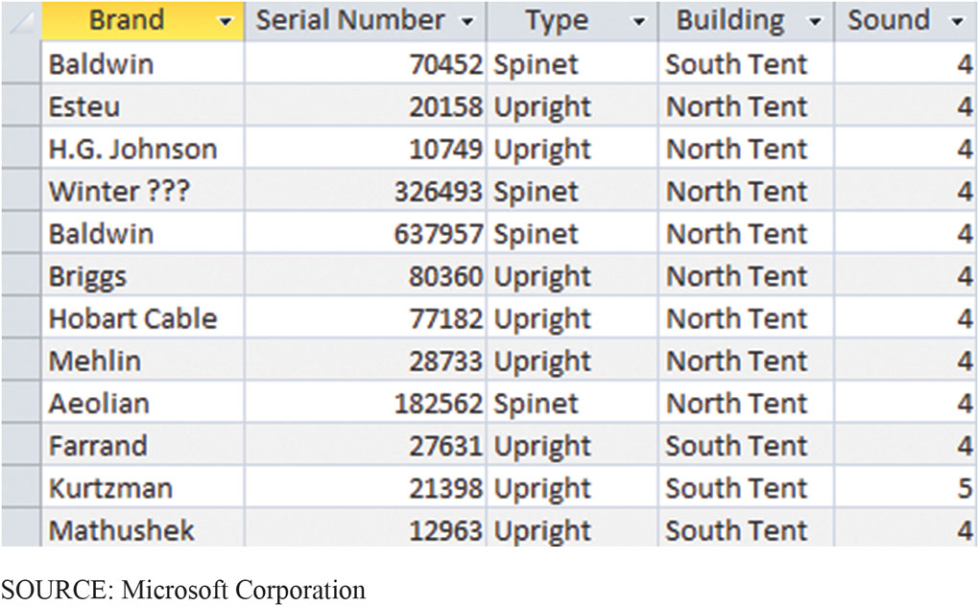
Results from Query
Case Study 5
Figure 5-22 Piano Sound Quality by Building

Slide 46
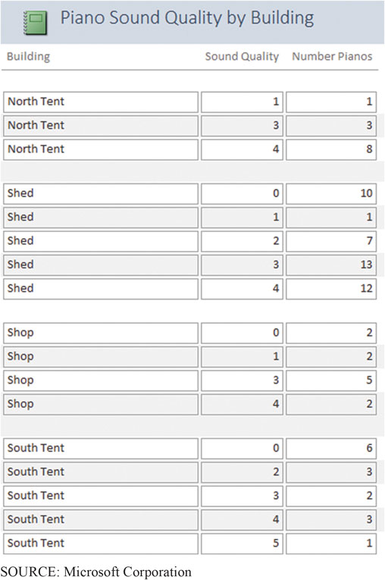
Piano Sound Quality by Building
Case Study 5
Figure 5-23 Results of Query from Figure 5-21

Slide 47

Copyright

